Slide 1
Vivo Active 2D Touch Surface
Andy Appeldorn
04-29-2020

Slide 2
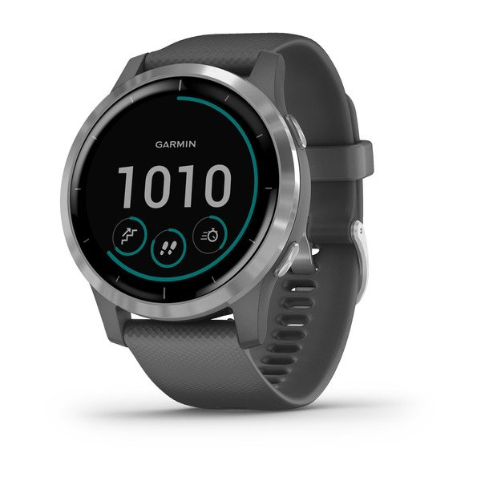
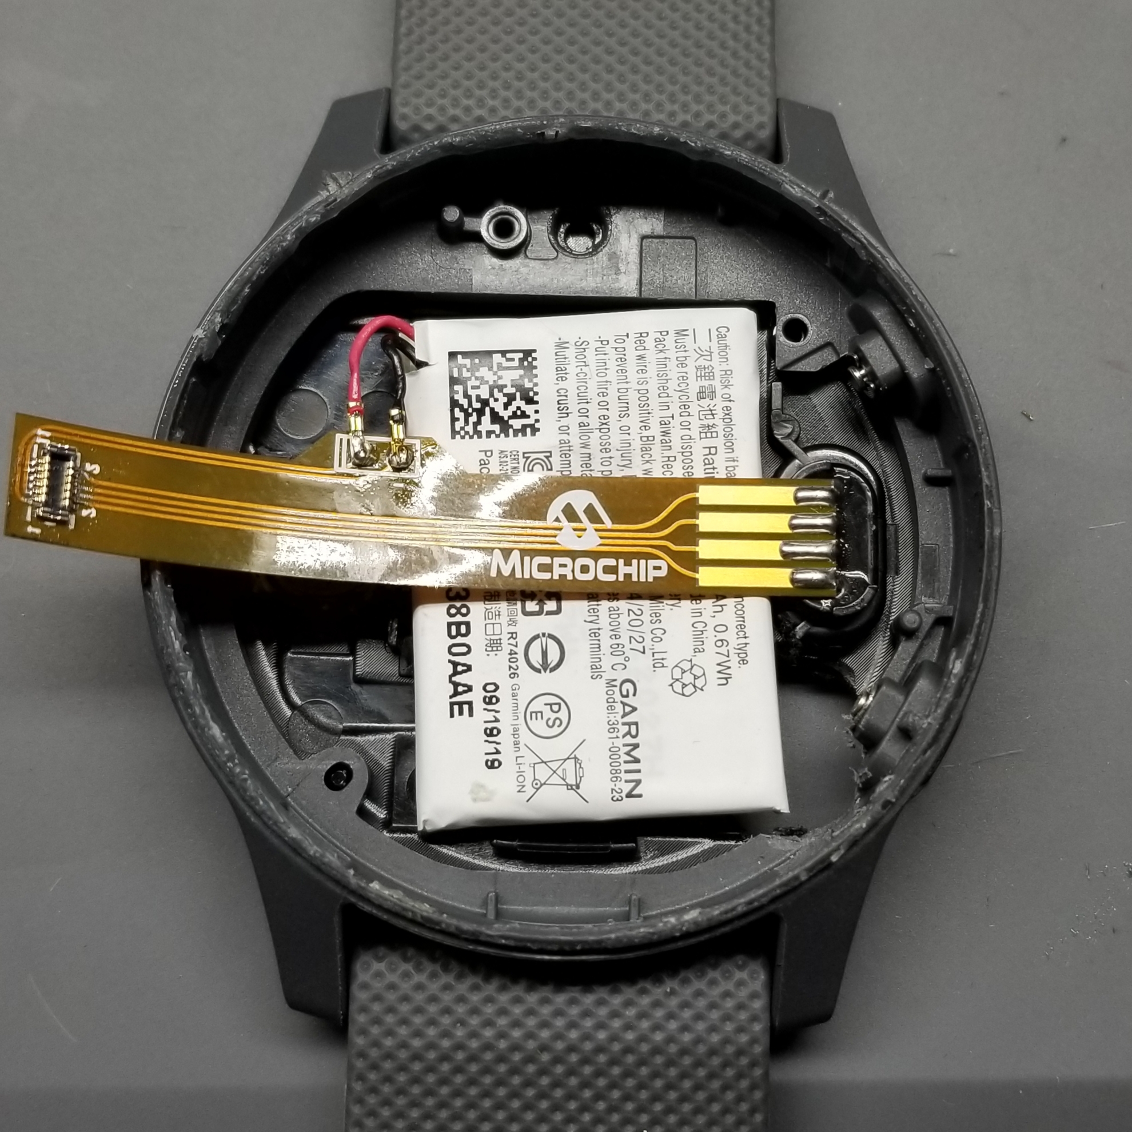
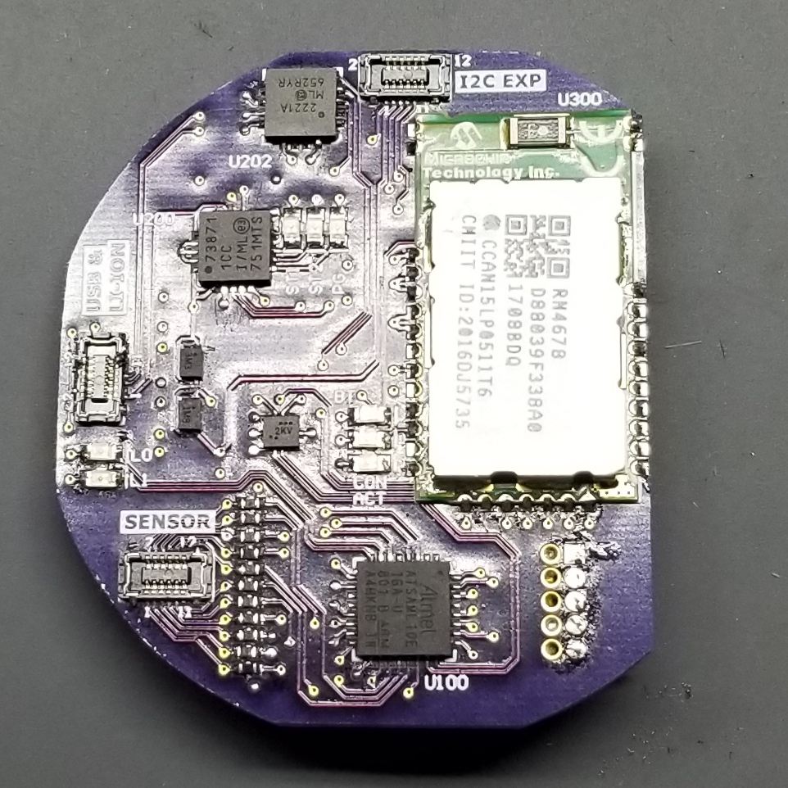
Demo Construction
Disassembled Garmin vívoactive® 4
Housing, Touch Sensor, Li-Ion Battery
Main PCB
SAML10 MCU for 2D cap touch
RN4678 for wireless comm to 2D GUI
BT 2.0 SPP Profile
USB Li-Ion Battery Charger IC
USB-CDC Comm for wired testing

Slide 3
Software Configuration

Slide 4
Hardware Overview
SAML10 Features
Core
Arm Cortex-M23 Core
32MHz (2.62 CoreMark/MHz and up to 31 DMIPS)
1.62-3.63V Operating Voltage
Memory
64/32/16KB Flash, 16/8/4KB SRAM, 2KB Data Flash
WLCSP Package Details
32 pin, 25 I/Os
.4mm lead pitch
2.79x2.79x.482 mm

Slide 5
Hardware Overview
Low Power Features
Active, Idle, Standby with partial or full SRAM retention and off standby modes
Active mode (< 25 μA/MHz)
Idle mode (< 10 μA/MHz) with 1.5 μs wake-up time
Standby with Full SRAM Retention (0.5 μA) with 5.3 μs wake-up time
Off mode (< 100 nA)
Sleepwalking peripherals
Embedded Buck/LDO regulator with on-the-fly selection

Slide 6
Hardware Overview
PTC Touch Controller
Up to 20 self, 100 mutual channels
Hardware noise filtering
Driven Shield Plus for moisture tolerance and noise immunity
Parallel Acquisition through Polarity control
Supports wake-up on touch from standby mode

Slide 7
2D Touch Surface
Self Cap acquisition
5x5 2D Touch Sensor from Vivo Active 4

Slide 8
Outline
Hardware overview
Presentation discussion
Ground plane simulating display capacitive loading
2D Touch Surface GUI Intro
USB Connected Operation
Battery Operation
Wet Operation
5% salt water solution, ½ TSP / 2 oz water
Powered by Li-Ion, data by BT
Bezel touch effect
Low Power and Acquisition Timing
Different power modes
Power Debugger Live w/ Acquisition Scope

Slide 9
Hardware Overview
Presentation
Ground plane simulating display capacitive loading

Slide 10
2D Touch Surface GUI Intro
Used to visualize cap touch data in the system
Demo will be relying on:
Touch Visualization Pane
Sensor signal levels
Noise
Touch Sensitivity
Touch coordinate detected
Gesture Pane
Gesture detected by touch controller
Not decoded in GUI

Slide 11
USB Connected Operation
Powered by USB, data by BT
Noise and signal
Draw horizontal, vertical, and diagonal lines
Slow and fast
Draw gestures
Single finger tap, swipe, wheel
Tow finger tap, swipe, pinch zoon
Bezel touch effect
Could be rejected by implementing palm rejection method, but may lose two finger operation due to sensor size

Slide 12
Battery Operation (Floating GND)
Powered by Li-Ion battery, data by BT
Noise and signal
Draw horizontal, vertical, and diagonal lines
Slow and fast
Draw gestures
Single finger tap, swipe, wheel
Tow finger tap, swipe, pinch zoon
Bezel touch effect
Could be rejected by implementing palm rejection method, but may lose two finger operation due to sensor size

Slide 13
Wet Operation
Testing using 5% saltwater solution, ½ TSP per 2 oz water
Powered by Li-Ion, data by BT
Water signal
Noise and signal
Draw horizontal, vertical, and diagonal lines
Slow and fast
Draw gestures
Single finger tap, swipe, wheel
Tow finger tap, swipe, pinch zoon
Bezel touch effect
Could be rejected by implementing palm rejection method, but may lose two finger operation due to sensor size

Slide 14
Low Power and Acquisition Timing
Presentation discussing different power modes
Power Debugger Live w/ Acquisition Scope

Slide 15
SAML10 Touch Surface Low Power
CPU
16MHz internal oscillator, no DFLL
32KHz internal oscillator
3.3Vdc
Buck regulator during active, LPVREG in sleep
Active w/ 16MHz internal oscillator = 415uA avg
Sleep w/ 32mS auto-scan = 29uA avg
Adjustable inactivity timeout to enter low power standby mode
Adjustable touch drift period for environmental recalibration

Slide 16
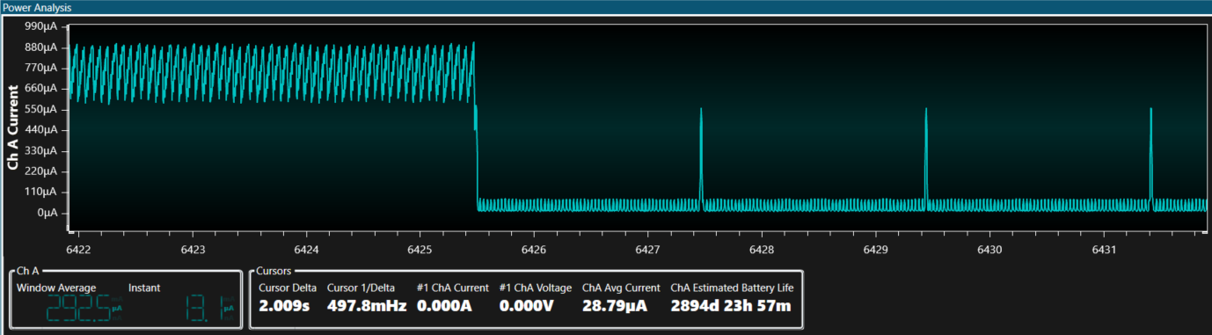
Touch Surface Standby Operation
Active Mode
Touch Timeout Event
Standby Auto-scan
Drift Calibration

Slide 17
Standby Auto-scan Power Comparison
Auto scan trigger period while in standby
QTM_AUTOSCAN_TRIGGER_PERIOD
Range: 8ms – 1024ms
@3.3Vdc

Slide 18
Drift Recalibration Power Comparison
Drift measurement period to wake and recalibrate reference values
DEF_TOUCH_DRIFT_PERIOD_MS
Range: 1 – 65535
32mS auto-scan rate
@3.3Vdc

